Slide 1
Functions & Interactivity
By Crystal Hess
http://csed.fun

Slide 2
Learning Goals
What is a function and why is it useful?
What is a keyword?
What is the difference between implementing and calling a function?
How are the x and y values for arcs and rectangles different in p5.js?

Slide 3
Functions
“Chunk” code into meaningful tasks/instruction sets.
Allow for code to be repeated more easily
In p5.js,
setup() is called when the program is first run, just like Arduino
Arduino has loop() that infinitely repeats, in p5.js, we use draw()

Slide 4
Try it: random() and draw()
Duplicate your creature sketch to creatureV2
Move everything in setup() EXCEPT creating the canvas and setting the background to a new function called draw()
Set the background to a random color (explore background() and random() in the docs)
Try moving the background to draw() and see what happens. Why does this happen?

Slide 5
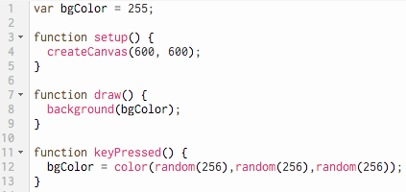
Interactivity through Events
Consider the code here
What is happening on Line 1?
Line 8?
Lines 11-13?
What do you expect to see when you first run the program?
What about after you push <enter> on the keyboard?
keyPressed() is built-in function that you can find in the p5.js API

Slide 6
Move the Creature
Let’s try something using the fact that the draw() function is being called repeatedly…
Add translate(mouseX, mouseY); at the top of draw() (inside the {}s though)
Note that mouse is written in lowercase letters, and the X and Y are uppercase; this is required, as these are keywords in p5.js
After adding the code, run your program and move your mouse.
What happened?
Why?

Slide 7
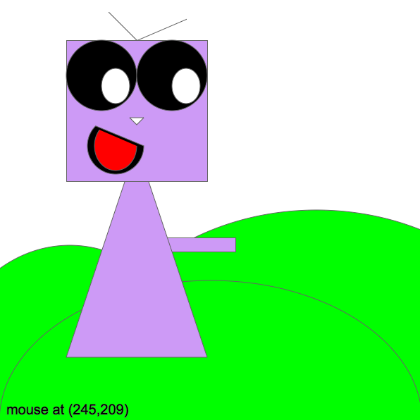
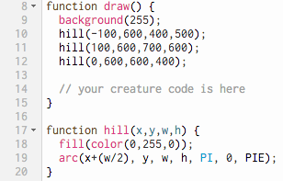
Repeat a shape on the Canvas
Let’s create a background of rolling hills for our creature

Slide 8
More about functions
Define/implement
put stuff in the {}s
Use/call
tell the function to execute
Overriding
give a new definition/implementation to an inherited function

